Slide 1

AIMES Housing Survey
MSDS 411 – Unsupervised Learning
Brandon Moretz & Sean Prentis

Slide 3
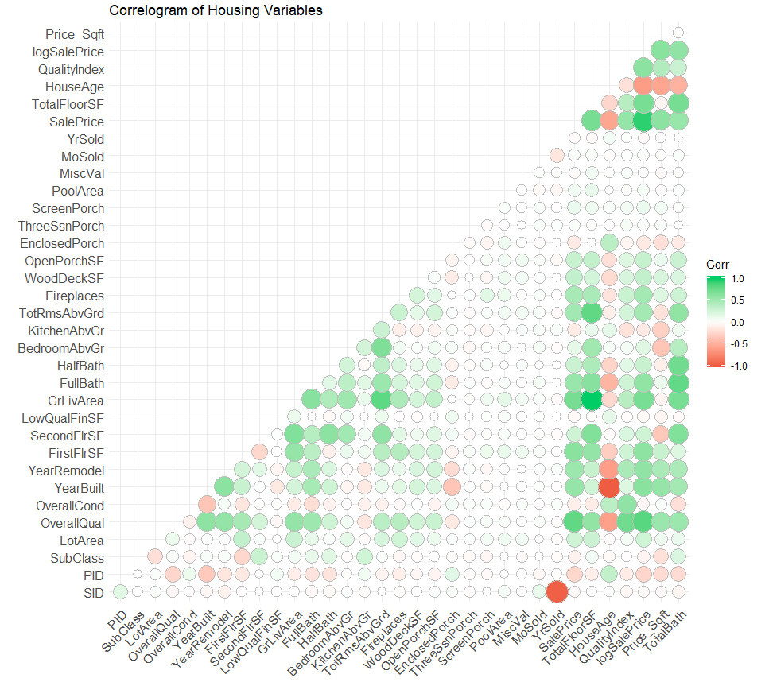
Variable Correlations

